Slide 1
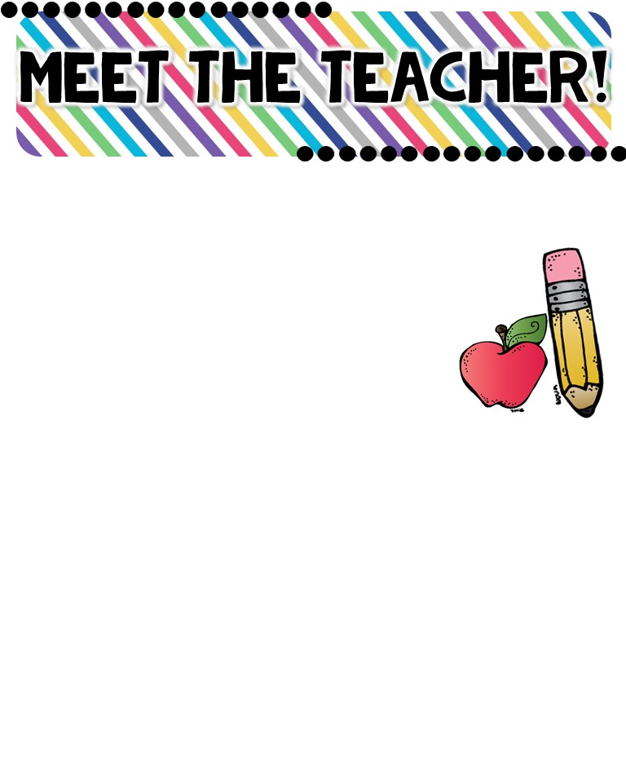
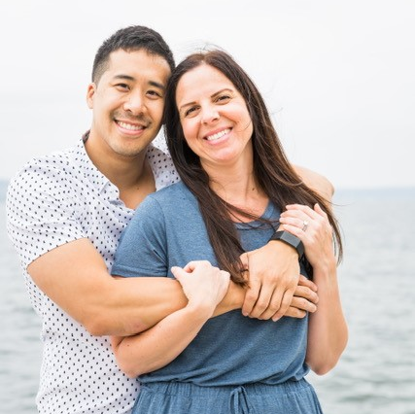
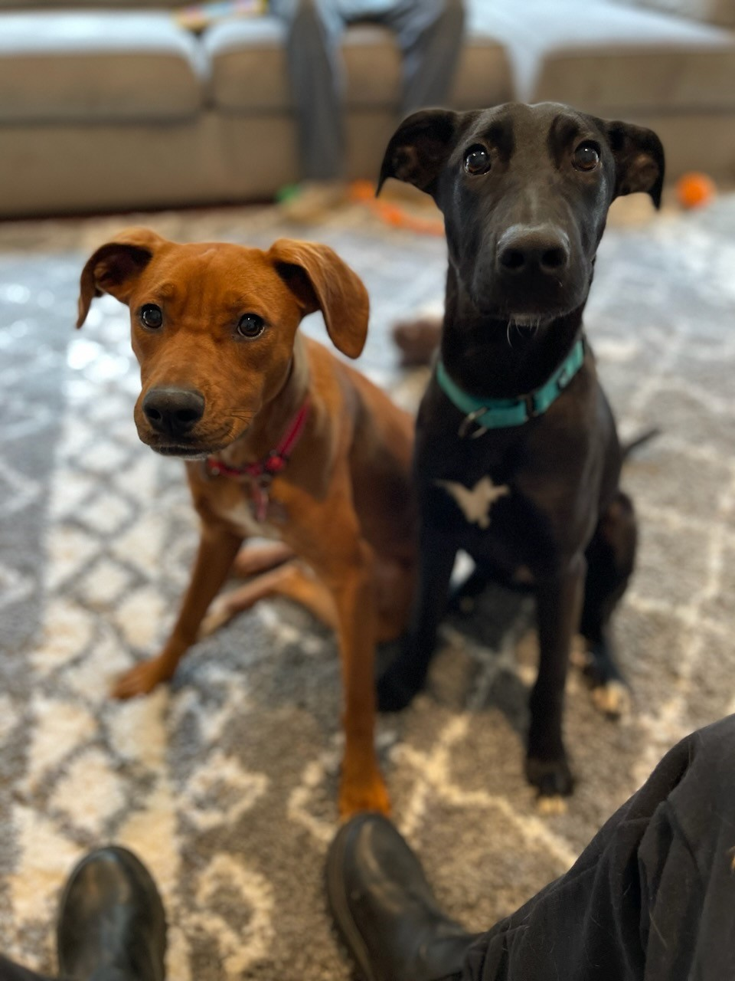


Mrs. Nguyen
The Basics!
Hi! I live in the Bothell area with my husband (Tim) and our 2 sons Jacob (5) and Jackson (baby). We also have 2 two-year-old rescue pups, Stella and Scarlett. I love traveling, reading, and spending time with my friends, family, and dogs!
MY CHILDHOOD!
While I was born in Delaware, I was so fortunate to grow up in Lake Mary, FL. I spent k-12th grade in Lake Mary. Close enough for cool field trips to Disneyworld as well as those beautiful, warm, and white sandy beaches.
MY FAVORITES!
MY EDUCATION!
Food: anything sweet ☺
Color: yellow
Drink: COFFEE ☺
Season: Fall
Sports: Football
Fast Food: Chick-Fila
Singer: Ellie Goulding
Subject: Math
Store: Amazon
Dessert: cookies
Candy: Twizzlers + Dots
Restaurant: Azuls
Flower: Star Gazer Lily
Hobby: traveling + working out
2024-2025 Amazon Class Wish List
In 2007, I graduated with a Bachelors of Science in Elementary Education from the University of North Florida. I continued on to graduate school at UNF, graduating with a Master’s in Education (Educational Technology)in 2008. I have been teaching ever since. ☺
CONTACT ME!
The fastest way to communicate with me is through ParentSquare. Please email me to join if you haven’t already!
Email: lnguyen2@everettsd.org
School Phone Number: (425) 385-7841
You can also write a note in your child’s blue folder!

